Slide 1
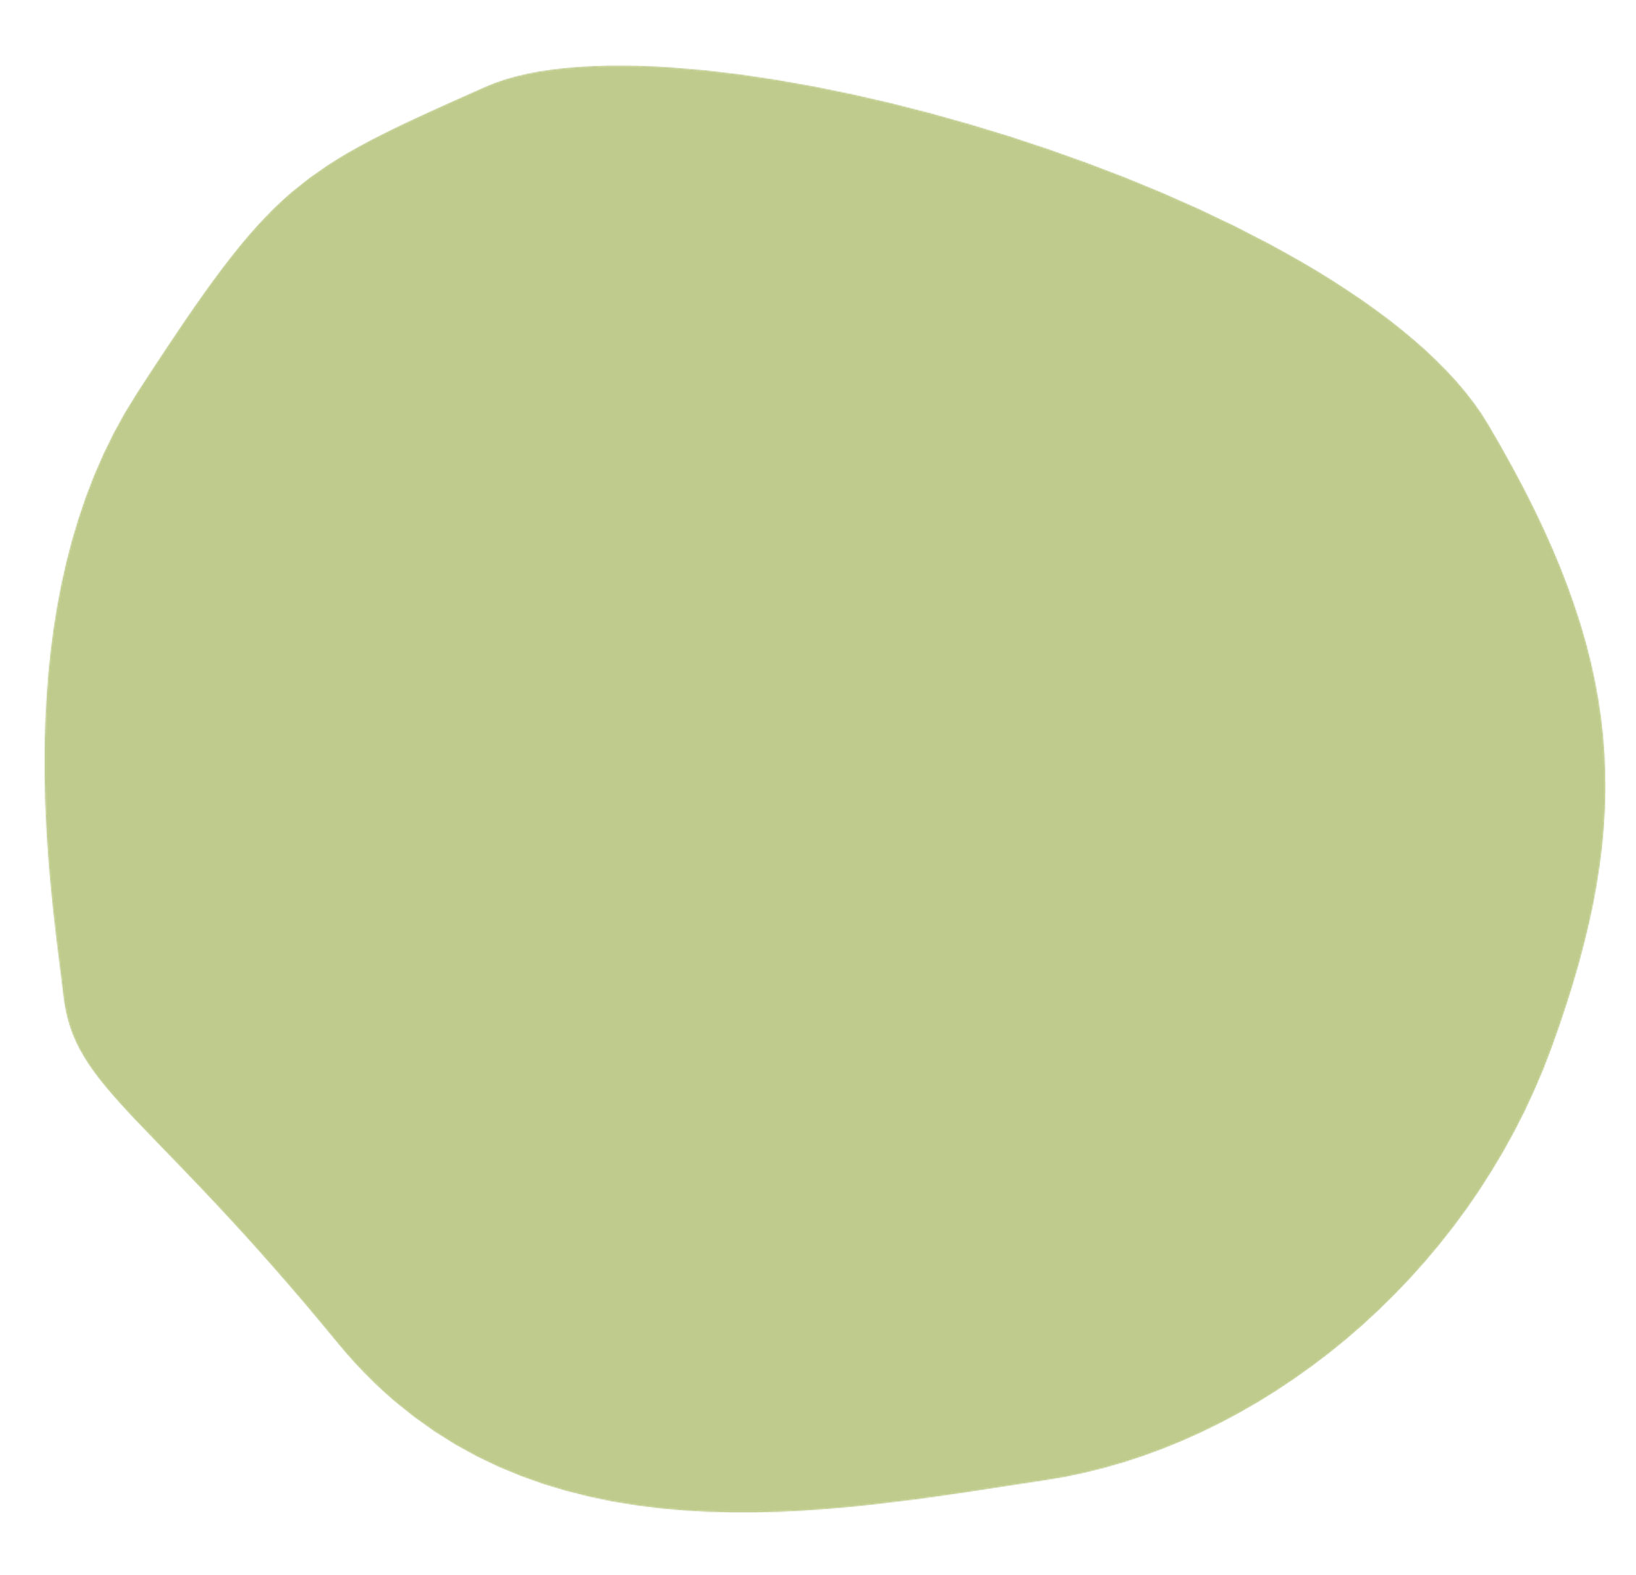
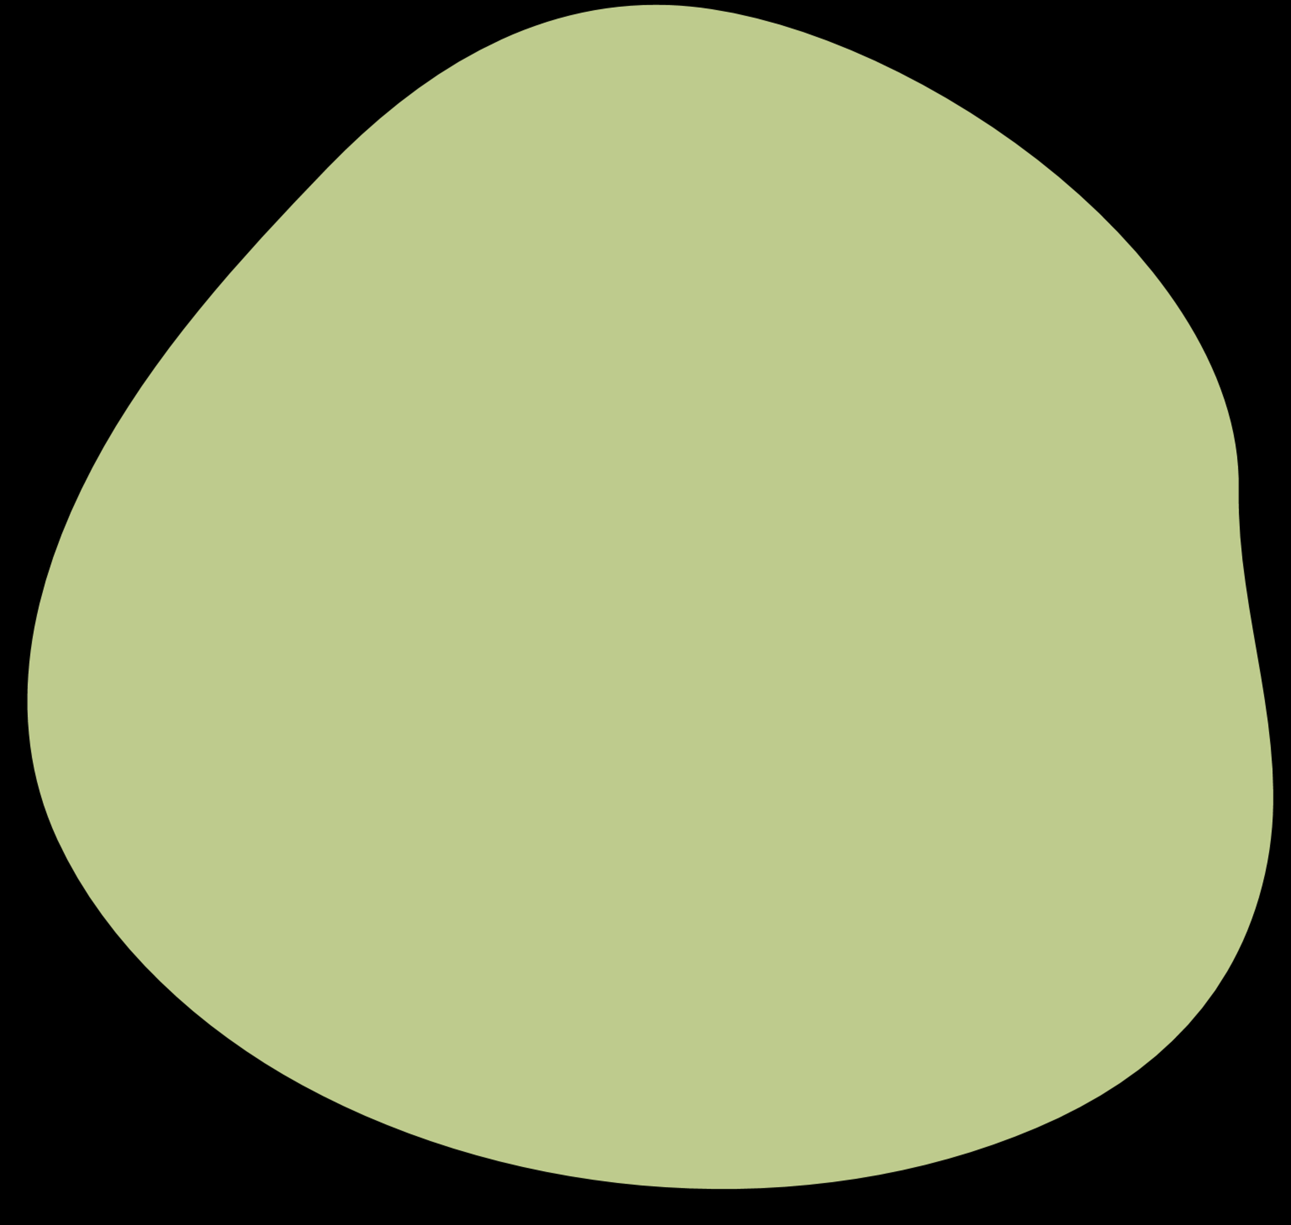
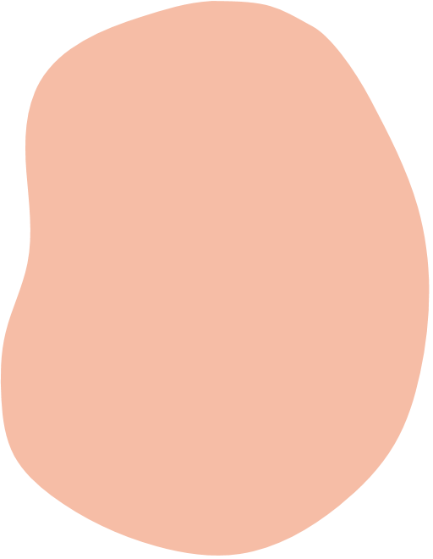

Matlab
Project
Diffusion-Limited Aggregation model
IT4110E - Scientific computing
Team members
Do Tuan Minh - 20200390
Nguyen Minh Huy - 20205158
Nguyen Tuan Hiep - 20205151
Pham Vuong Tu - 20200550
Under the assistance of
Ph.D. Vu Van Thieu

Slide 2
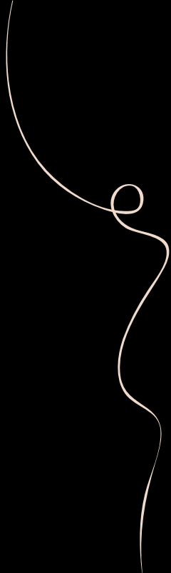
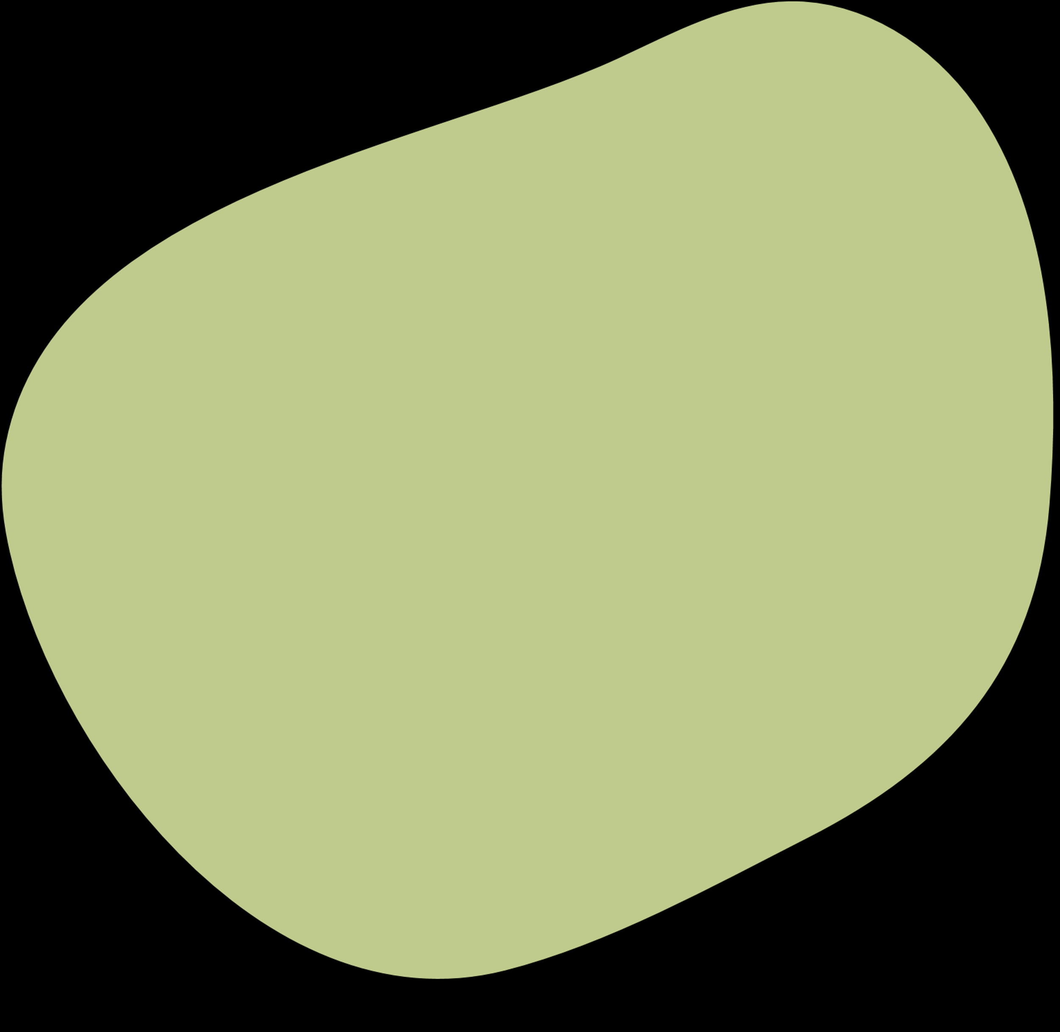
Content
Review
1
3
Introduction
Results
2
4
Conclusion
Theory

Slide 3
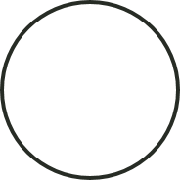

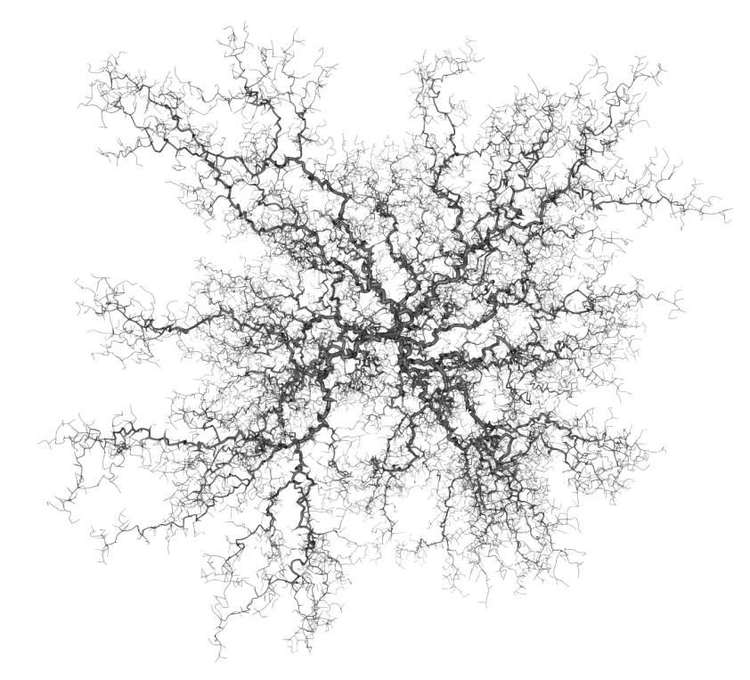
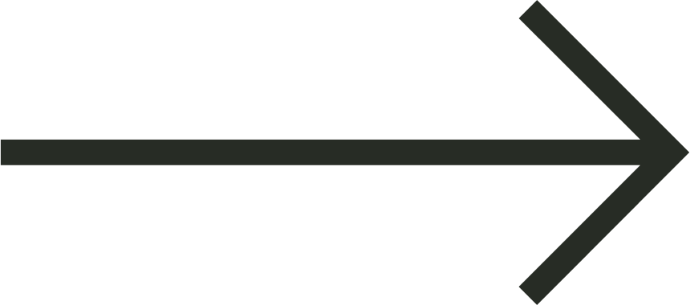
1.1. Problem introduction
Diffusion-limited aggregation (DLA) is a process that describes the random undirected growth of individuals.
For example: The following image describes the dendritic growths

Slide 4

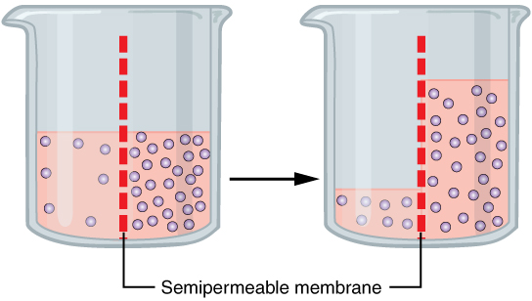
1.2. Practical application
viruses
living
creatures
algaes
Describe the development of
cells
diffusion
physical
processes
osmosis

Slide 5
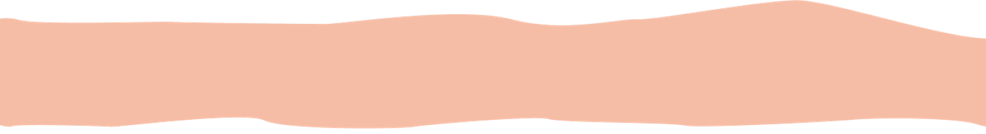
1.3. Problem statement
In this report: Our group will be presenting the process of simulating the growth of a virus-producing individual
In a finite environment containing food, the virus will not stop eating food and growing.

Slide 6
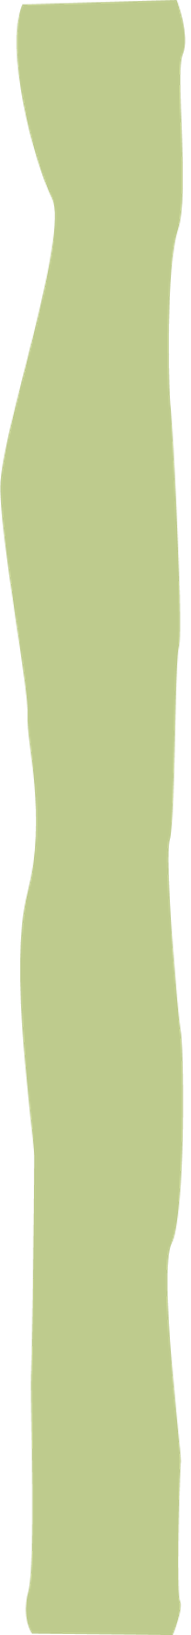
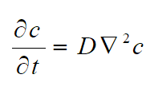
2. Theory
2.1. Theory statement
The viruses will develop from 1 initial virus. The growth of viruses in food depends probabilistically on the surrounding boxes.
The food rate is constantly changing. The box eaten by viruses will run out of food, then the food difference is changed and determined by the diffusion equation
D: diffusion parameter
c: the rate
This equation will be solved by Successive Over Relaxation method.

Slide 7
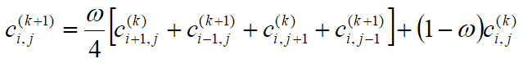
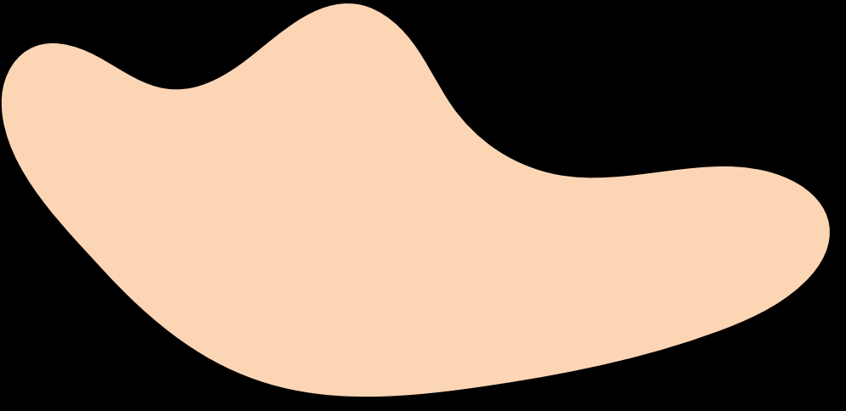
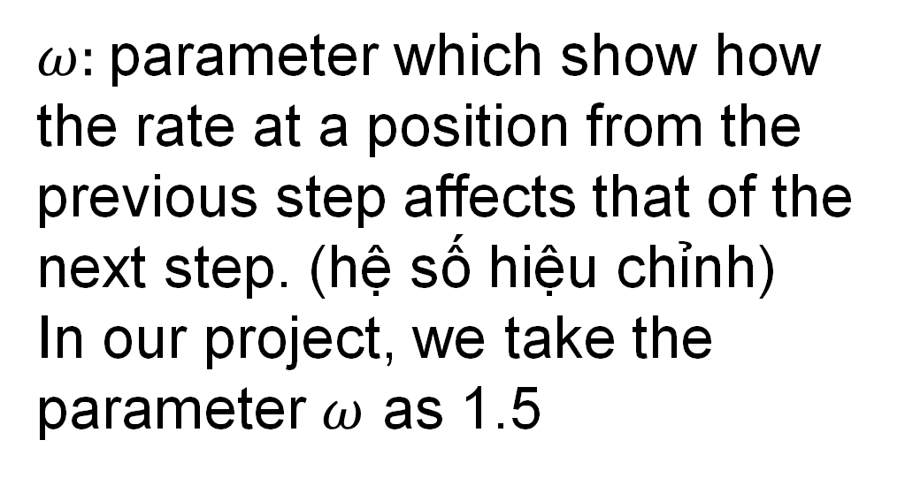
2.2. SOR method
SOR method uses this formula to calculate C_{i,j}
$ω:$parameter which show how the rate at a position from the previous step affects that of the next step. (hệ số hiệu chỉnh)
In our project, we take the parameter $ω$ as 1.5
void sor(){
for(int i=0;i<row;++i){
for(int j=0;j<column;++j){
if(i==0 || i==row-1||j==0 || j==column-1) {
c[i][j]=1;
}else c[i][j]= w/4*(c[i+1][j]+c[i-1][j]+c[i][j+1]+c[i][j-1])+(1-w)*c[i][j];
}
}
}

Slide 8
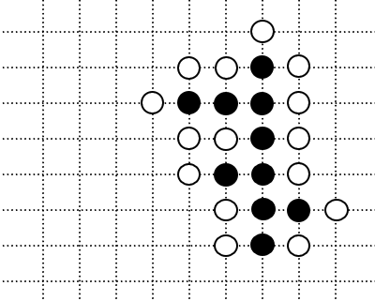
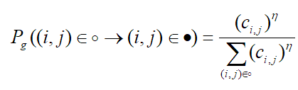
2.3. Application in DLA
The algorithm to demonstrate DLA process:
Step 1: Solve the diffusion equation with SOR method to get the food rate matrix.
Step 2: Let the virus grows.
The probability that the virus grows in a white dot:
η is in (0.5, 2)
Step 3: Back to Step 1

Slide 9
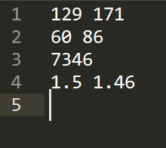
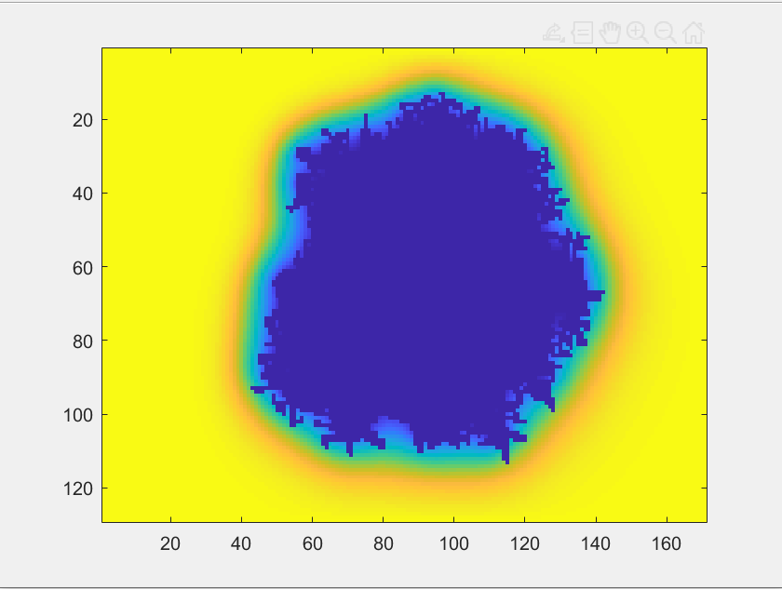

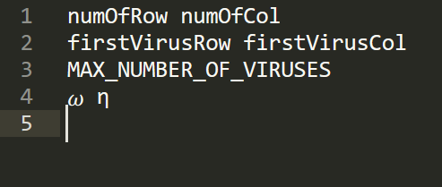
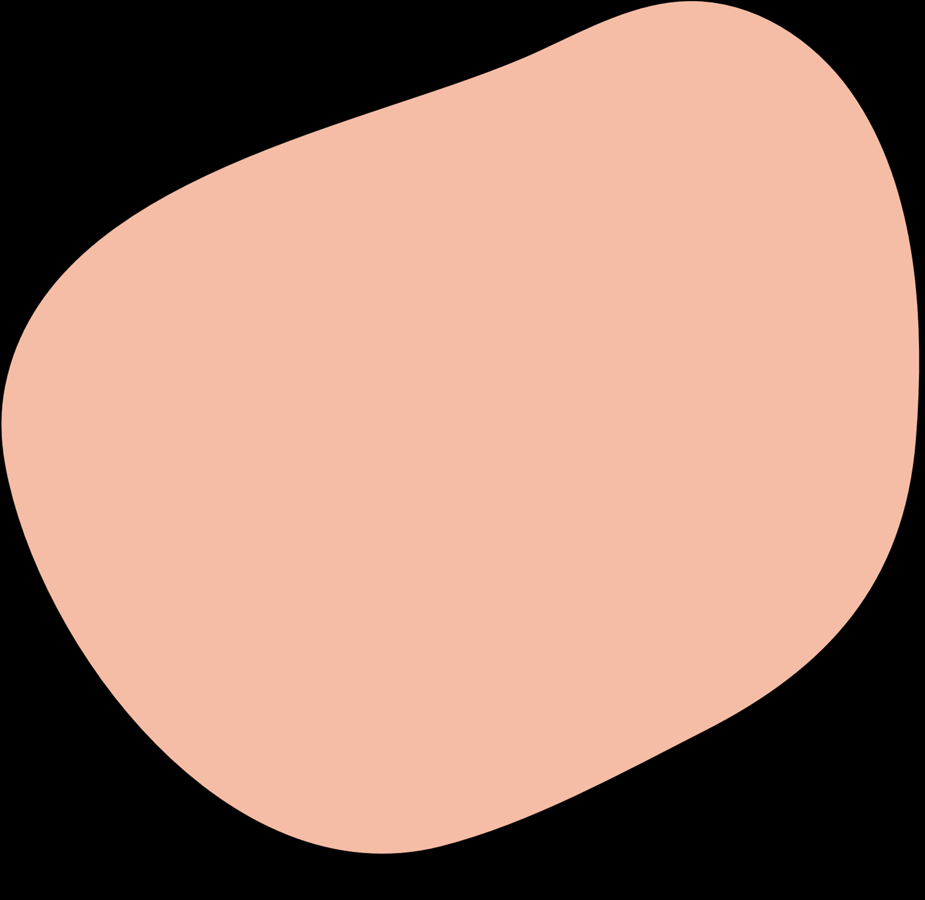
3. Results
COMPANY
LOGO

Slide 10
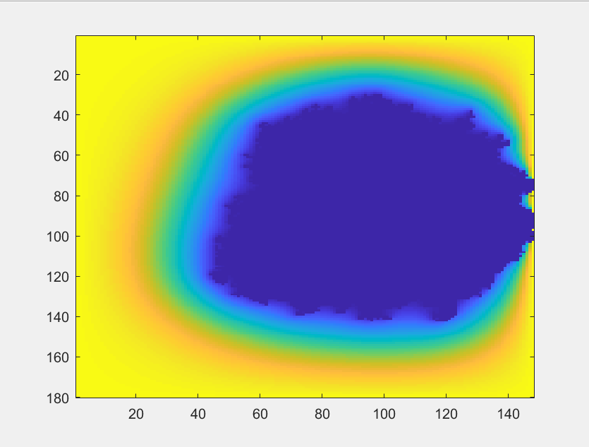
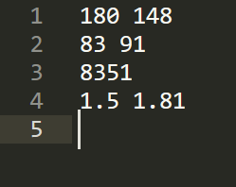

Target Audience
COMPANY
LOGO

Slide 11
4. Conclusion
Diffusion Limited Aggregation (DLA) has usually been studied in 2 dimensions as a model of fractal growth processes such as branching, lightning, snowflakes, mineral deposits, and coral.
For deeper researching, the basic principles are extended into 3 dimensions and used to create believable models of root systems.

